Slide 1

Proposal
by Sadman Sakib Khan Promit

Slide 2
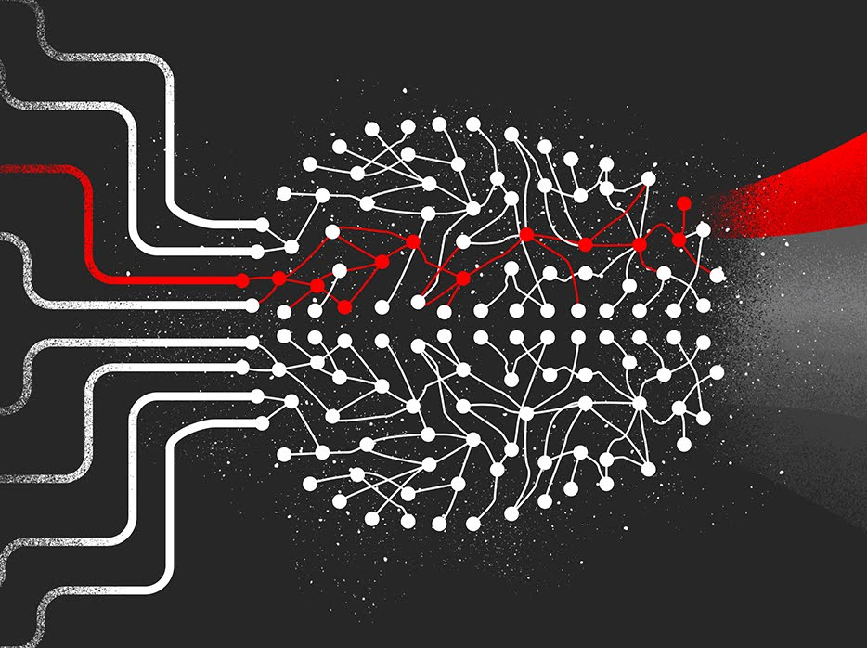
Surveillance using Deep Learning
Motivation
The system will be able to detect the following events
Face Detection
Fire
Violence
Weapon

Slide 3

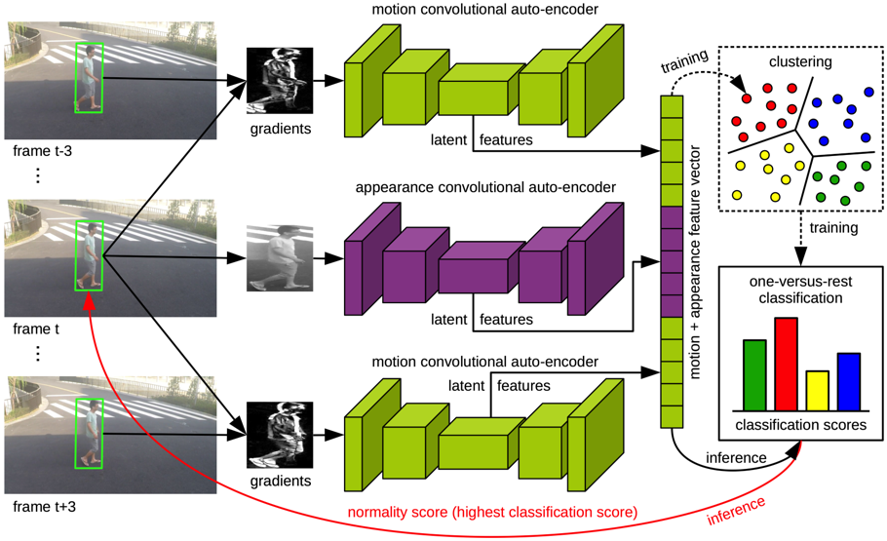

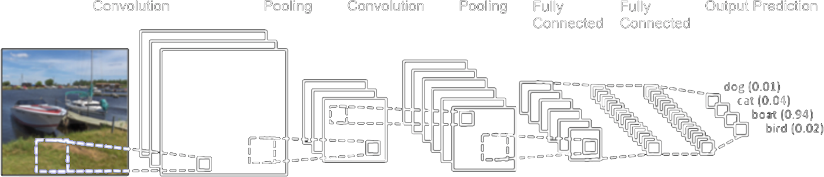
Surveillance using Deep Learning
Algorithms
CNN
LSTM

Slide 4

Requirements
Face Datasets available at Kaggle
Human Faces Dataset (107 GB)
Face Mask Lite Dataset (25 GB)
Flickr-Faces-HQ Dataset (FFHQ) (21 GB)
70,000 Real Faces 1 (20 GB)
Flickr-Faces-TFrecords- 512x512 (19 GB)

Slide 5
Requirements
Fire Datasets available at Kaggle
Wildland Fire Percolation Datasets (4) (22 GB)
Fire n Smoke (3 GB)
Fire Images Database (2 GB)
Flame_UAVS (2 GB)
FireDataset (1 GB)

Slide 6
Requirements
Violence Datasets available at Kaggle
Anomaly-Detection-Dataset-UCF (41 GB)
Protests around the world (36 GB)
Video Fights Dataset (12 GB)
Real Life Violence Situations Dataset (4 GB)
Smart-City CCTV Violence Detection Dataset (SCVD) (1 GB)

Slide 7
Requirements
Weapon Datasets available at Kaggle
Weapons from Image_net (2 GB)
Weapons in Images (1 GB)

